Slide 1
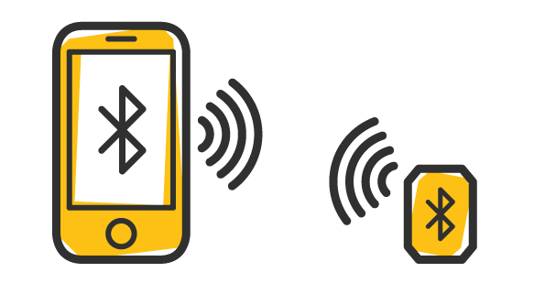
IKT200 – INTRODUKSJON TIL INTELLIGENTE SYSTEMER IKT200 - INTRODUCTION TO INTELLIGENT SYSTEMS
Lecture 1 (of 12)

Slide 2
Who am I doing?
Responsible for
Security in Mobile Applications
Intelligent systems
Education
BSc in Computer Science
MSc in Computer Science
PhD in IT (software engineering track) – Web Service, SOA, Mobile Applications, and HCI
Associate Professor at Kristiania University College
Researches: Mobile applications, Software architecture, Mulsemedia, E-Learning, and Business Process Engineering.

Slide 3

Expectations

Slide 4
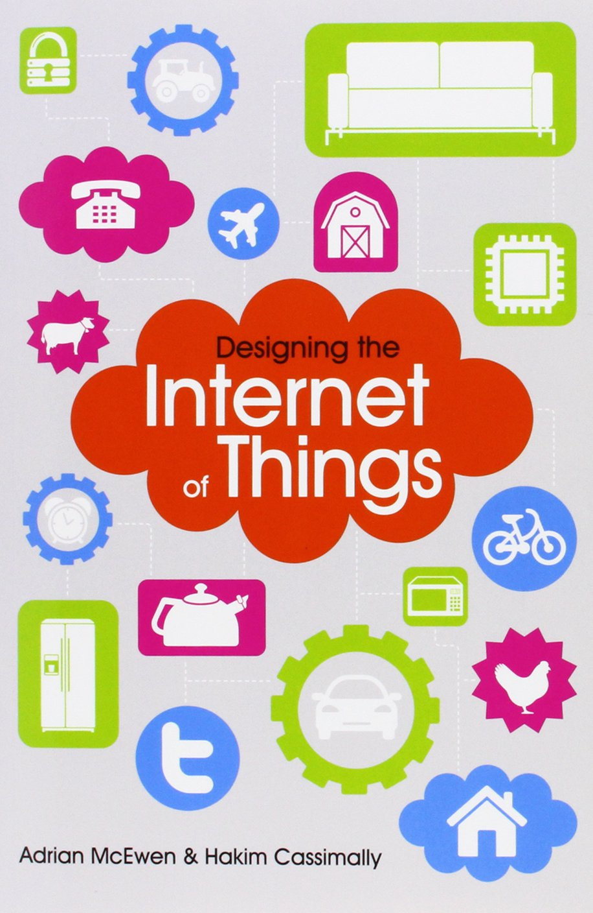
IKT200, structure
Teaching:
12 sessions, 4 hours teacher-controlled per session.(Theory about 2 hours, exercise assignment the rest.)
At least as many hours of self-study!
Textbook:
”Designing the internet of Things”, by McEwen & Cassimally.

Slide 5
TEK304 - Intro to Intelligent Systems (Autumn '19)
Credits | 7’5
Teaching language
Program | Required at Bachelor of IT – Intelligent Systems
Absolute prerequisites
Recommended prerequisites | None
Teaching | Autumn
Course coordinator

Slide 6
Objective
The work on this course will give the student knowledge about business models, ecosystems and technologies related to intelligent systems. Students gain knowledge of sensors, control systems, infrastructure and artificial intelligence. The course will provide students with skills in assessing / comparing which technologies should be selected for a given scenario and choosing the right management and distribution model. The student should know the laws and regulations governing this ecosystem and be up to date on ethical issues related to intelligent systems.

Slide 7
Learning outcome
Knowledge - the candidate must Have knowledge of intelligent systems. Have knowledge of the Internet of Things, including sensors, actuators and controllers. Have knowledge of artificial intelligence, including agents, finite state machines, expert systems and search algorithms such as A *. Know the important laws and regulations that govern this market / ecosystem. Be familiar with the process of manufacturing solutions within intelligent systems, including: user group identification, requirement discovery, design, development, testing, production setup and maintenance / further development.

Slide 8
Learning outcome (cont’d)
Skills - the candidate should Be able to explain what an object must contain for it to enter the Internet of Things. Be able to use artificial intelligence based on finite state machines, expert systems and search algorithms. Be able to perform a systematic and documented comparison of technologies and systems. Understand how intelligent systems can be linked to a company's business operations. General competence - the candidate must Reflect on ethical issues related to intelligent systems. Examination Individual written exam 25 %, no aids Individual written exam 75 % hand in.

Slide 9
Course content
Week | Topic | Resource
34 (Aug. 22) | Introduction Motivation IoT: Sensors, Actuators, Controllers | Text book, Chapter 1
35 | AI: Agents AI: Finite State Machines IoT: Design principles for connected devices | Textbook, Chapter 2
36 | AI: Rule-based ("expert") systems Turing and Eliza IoT: Internet Principles Beacon technology | Textbook, Chapter 3
37 | IoT: Thinking about prototyping AI: Introduction to Pathfinding (part 0) | Textbook, Chapter 4
38 | IoT: Prototyping Embedded Devices AI: Pathfinding part 1 | Textbook, Chapter 5
39 | Guest lecture by company: robotics

Slide 10
Course content (cont’d)
Week | Topic | Resource
40 | IoT: Prototyping the Physical Design AI: Pathfinding part 2 | Textbook, Chapter 6
41 | AI: Steering Behaviors IoT: Prototyping Online Components | Textbook, Chapter 7
42 | IoT: Techniques for Writing Embedded Code IoT: Business models | Textbook, Chapter 8 Textbook, Chapter 9
43 | Guest lecture with workshop in machine learning
44 | IoT: Moving to Manufacture IoT: Ethics | Textbook, Chapter 10 Textbook, Chapter 11
45 | Exam preparation Course summary

Slide 11
Today's themes
Motivation
About intelligent systems
Content in the subject matter
Internet of Things - overview (textbook, chapter 1)
Sensors, Actuators, Controllers

Slide 12
Motivation

Slide 13
What are Intelligent Systems?
Any suggestions from you? Intelligent systems are a broad term, and below this we can put, among other things:
Data Scientist: The Sexiest Job of the 21st Century!
Machine Learning / Artificial Intelligence.
Artificial intelligence is at full speed into the automotive industry and our everyday lives (Kunstig intelligens er på full fart inn i bilindustrien).
Google's self-driving cars are a good example of this (Googles selvkjørende biler).
(NB: Of course, artificial intelligence is VERY MUCH more than the car industry!)
Internet of Things (IoT).
Here it is too beacon teknologi (Near Field Communication - NFC) a hot topic.

Slide 14
Intelligent systems: the breadth
As mentioned, intelligent systems is a broad concept.
Here are some exciting (and some slightly scary?) themes which are very relevant.
Has everything been in the car industry, self-driving cars. Example, look at BMW autonomous driving project.
But pushing so much technology has a downside also
What challenges do you see?

Slide 15
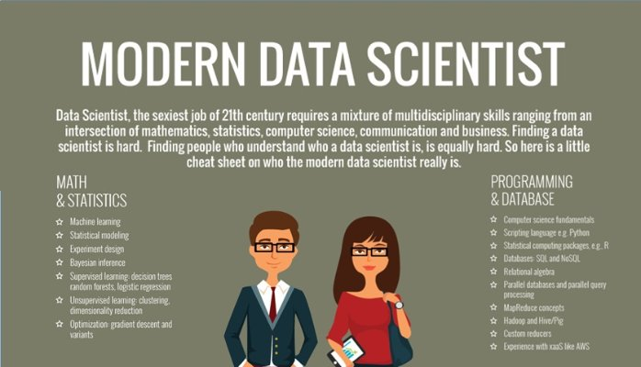
The breadth: Data scientist
Big data, analysis … Data Scientist! :-)

Slide 16
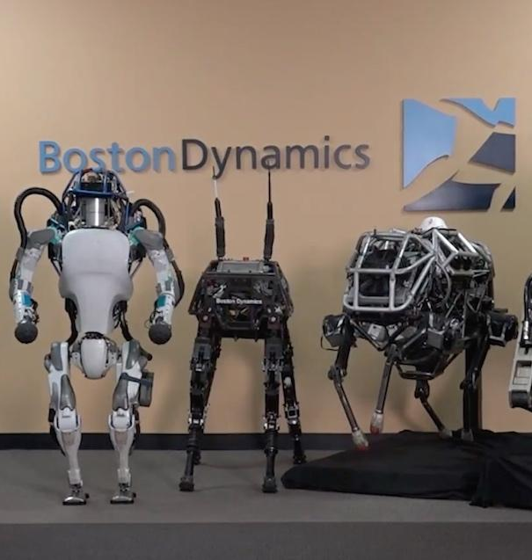
The breadth: artificial intelligence
Robots, of course, listen with artificial intelligence!
For example, these from US Boston Dynamics:
BigDog (2010)
WildCat (2013)
Atlas (2016/2018)

Slide 17
The breadth: machine learning
Traditionally, computers solve problems by being told how to solve the problem.
Artificial Intelligence (AI) is about developing computer systems that can learn from their own experiences and solve complex problems in different situations and environments.
Machine learning is an algorithm that learns itself to solve problem. Often this happens by finding patterns in large amounts of data.
In this way, machines will be more similar to humans – like automated processes – eg. self-driving cars.

Slide 18
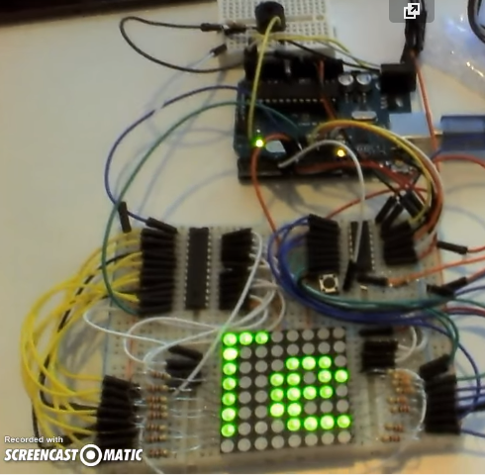
Width: Internet of Things (IoT)
The theory of the IoT is a large part of IKT200 subject.
Next semester you will build this type of solution itself.
First, embedded systems
Then machine to machine communication.

Slide 19
Internet of Things

Slide 20
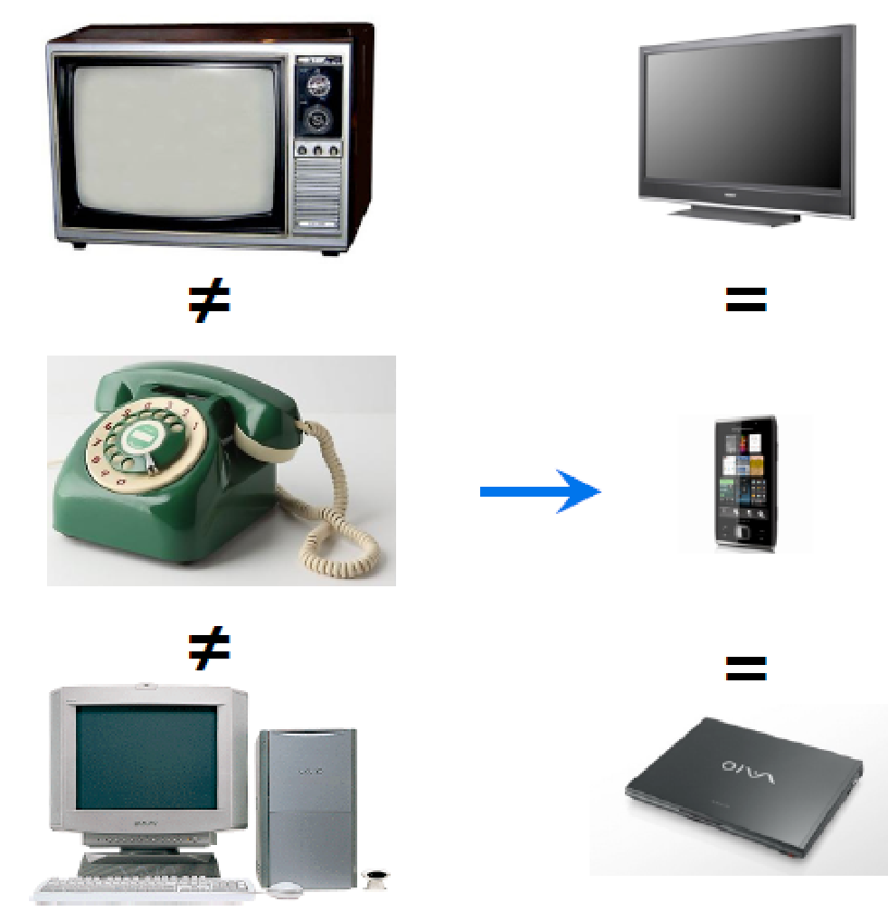
Computing in the 21st

Slide 21
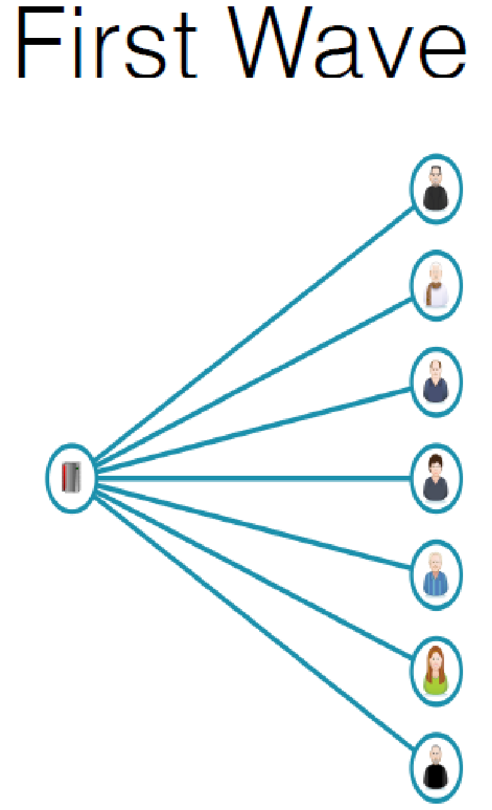
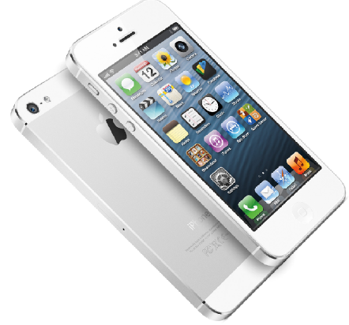
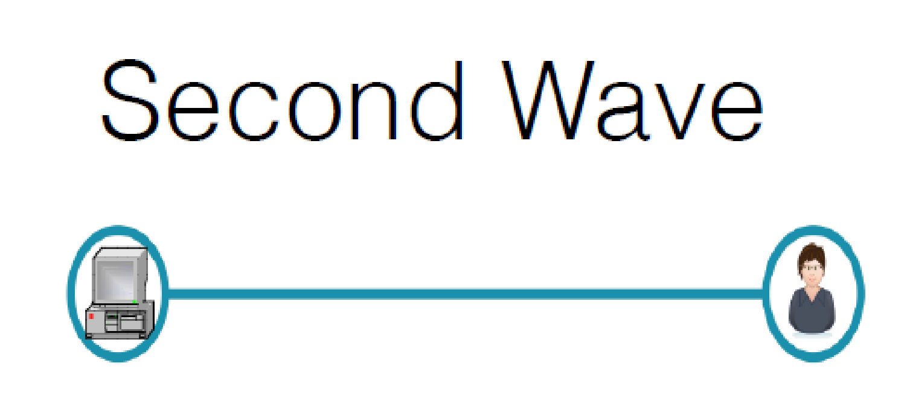
Computing in the 21st

Slide 22
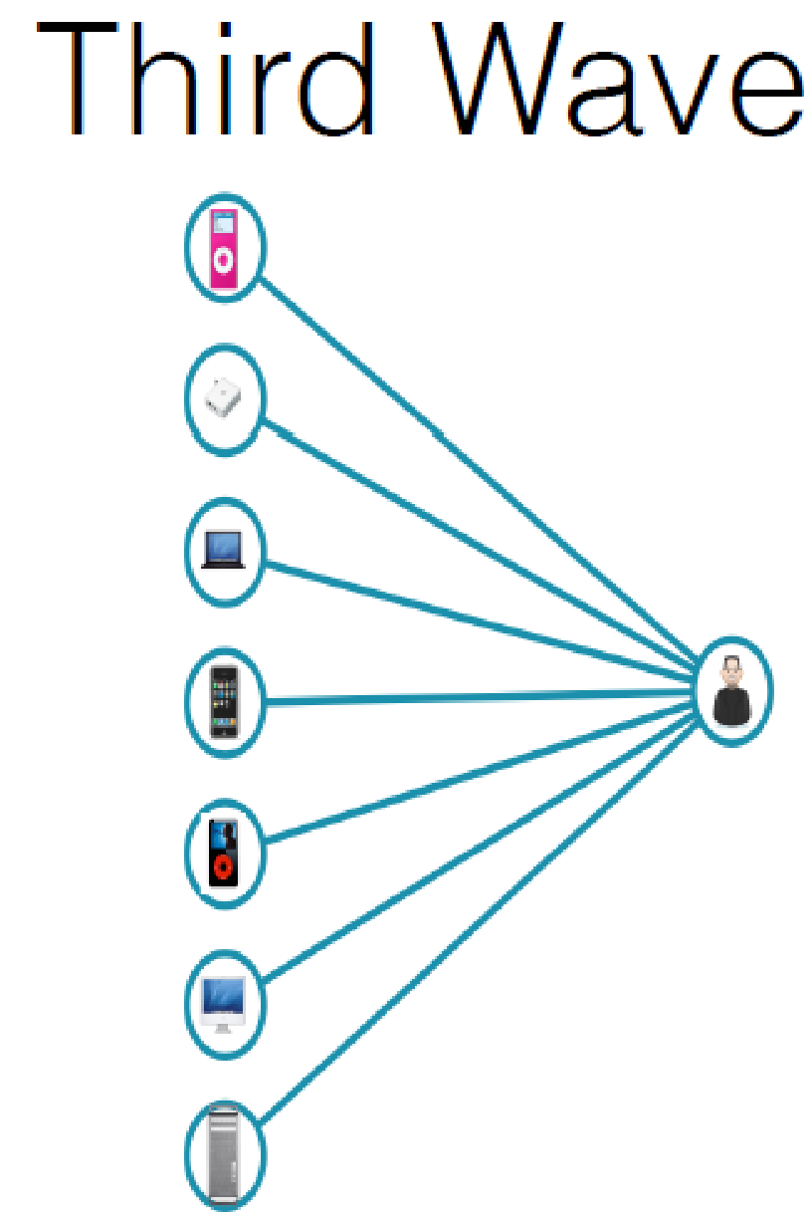
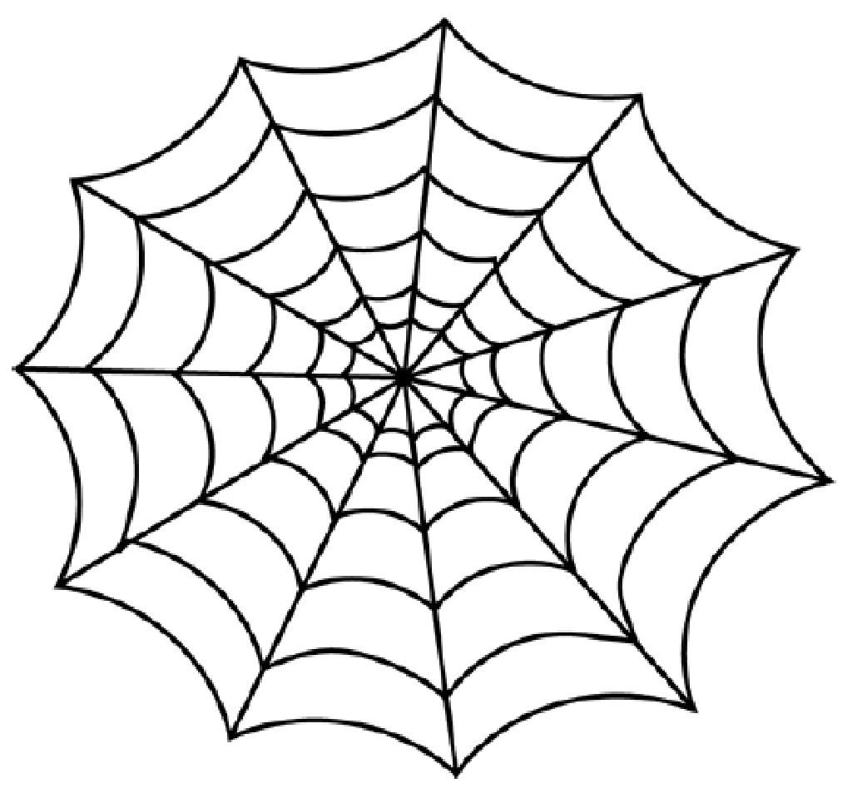
Computing in the 21st

Slide 23
Computing in the 21st
Computing in the 21st century will become a ubiquitous service resource that will weave itself into the fabric of everyday life
… the idea of a “personal” computer itself is misplaced and that the vision of laptop machines is only a transitional step…
(Weiser, 1991)

Slide 24
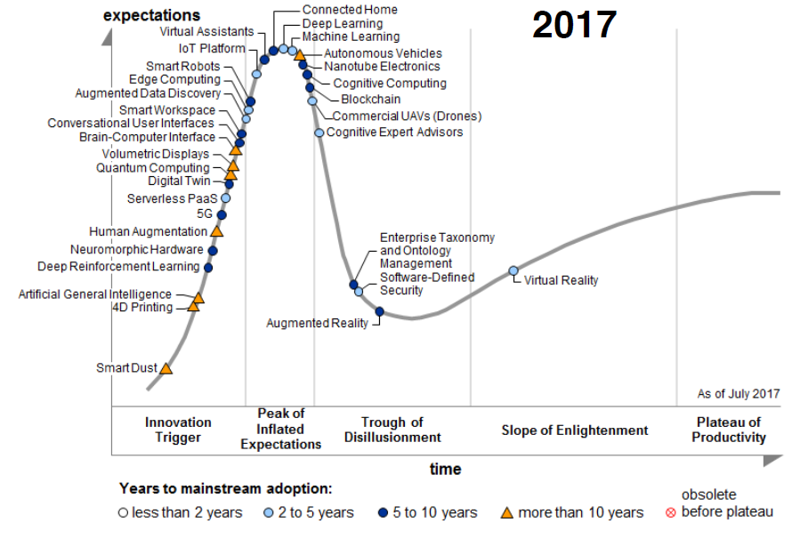

Slide 25
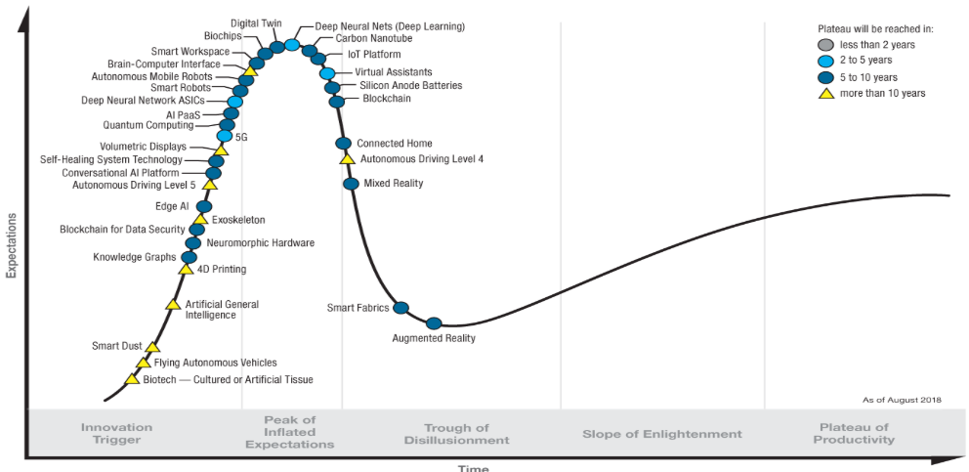
Hype Cycle for Emerging Technologies, 2018 (Source: Gartner)

Slide 26
Internet of Things in Context

Slide 27
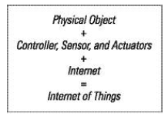
Sensor, Actuator and Controller
For the Internet of Things (IoT) we talk a lot about sensors, actuators and controllers.
What is this?
Sensor: Receives real-world input.
Actuator: Provides feedback to the real world.
Controller: The data device that controls it all.

Slide 28
IoT technology
There are several reasons for the development of IoT:
Hardware prices have fallen (as always) and now they are so low that manufacturers do not see financial problems in putting microchips in everything from washing machines to cars.
Like in prices, the physical size has decreased and made it easier to place data power in other machines.
The prices of broadband services are so low that "everyone" can afford it.

Slide 29
IoT technology
There are more reasons:
Apps and modern web standards have made it much easier to build the required client and back-end software.
In addition, the exchange of data / information has become so large (smartphones, etc.) that they see one growing market for this type of hardware.

Slide 30
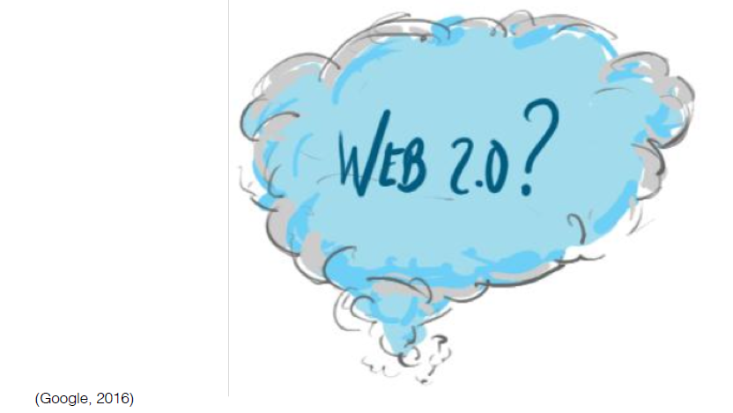

Slide 31
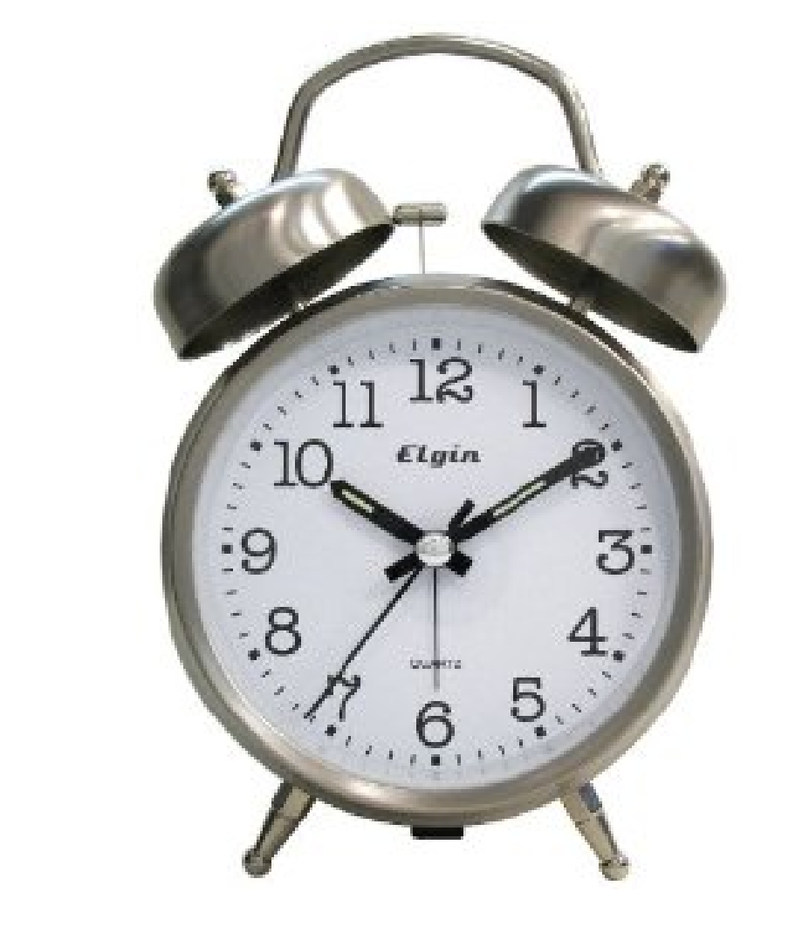
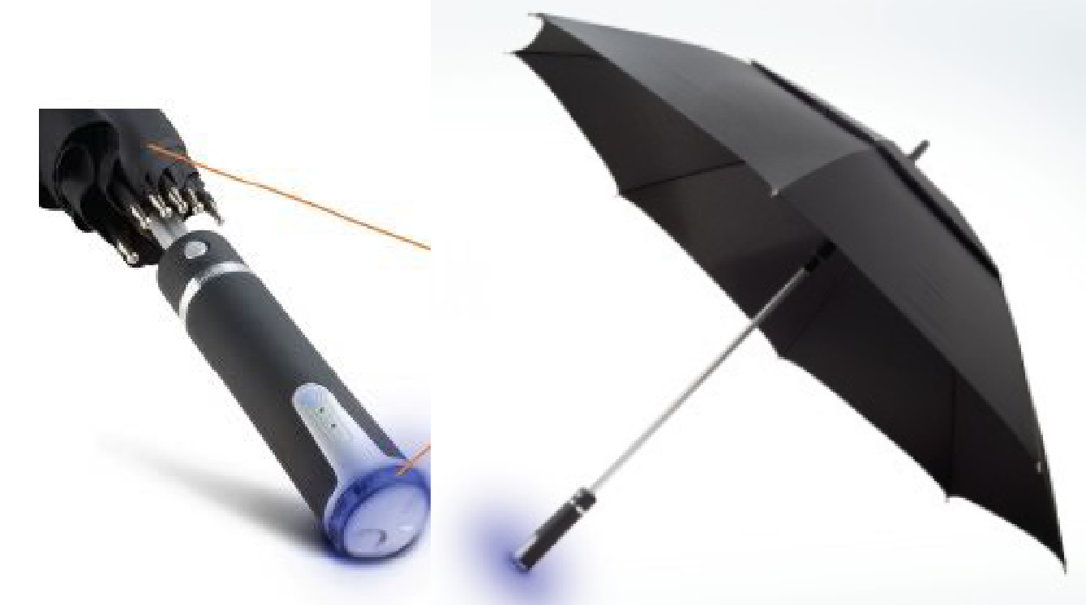
What is app # 1 for you as a user?
Weather forecast enabled umbrella
Clock notices delayed train

Slide 32
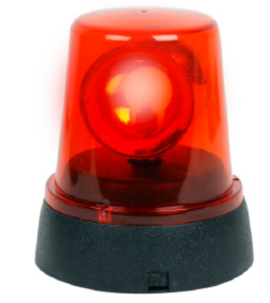
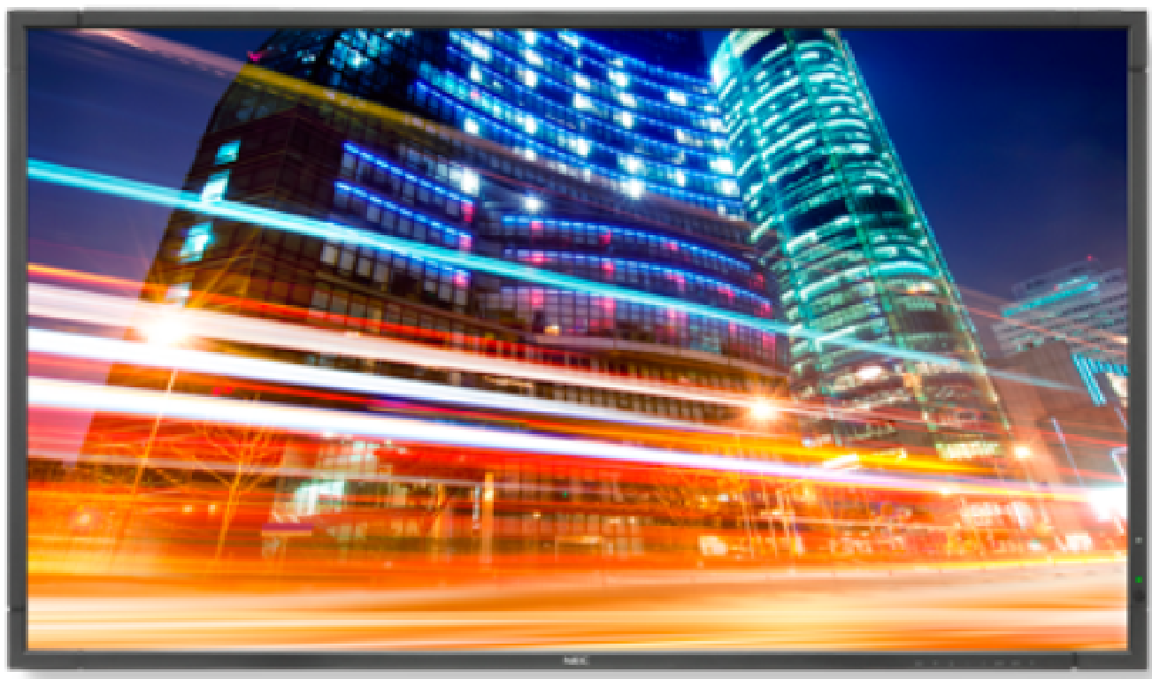
blinking light reminds you it’s time to take your tablets

Slide 33
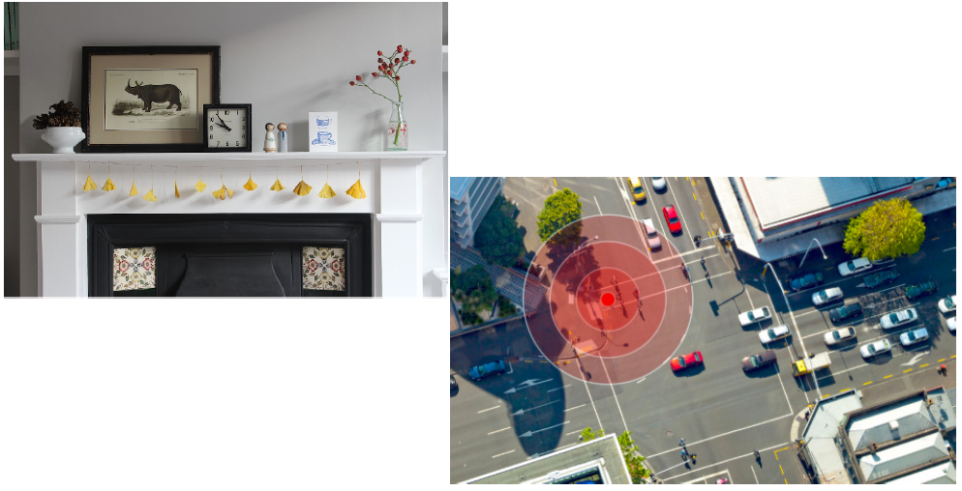
LCD display at a bus stop- expected time vs realtime
mantelpiece at home: an ornament with dial notices

Slide 34
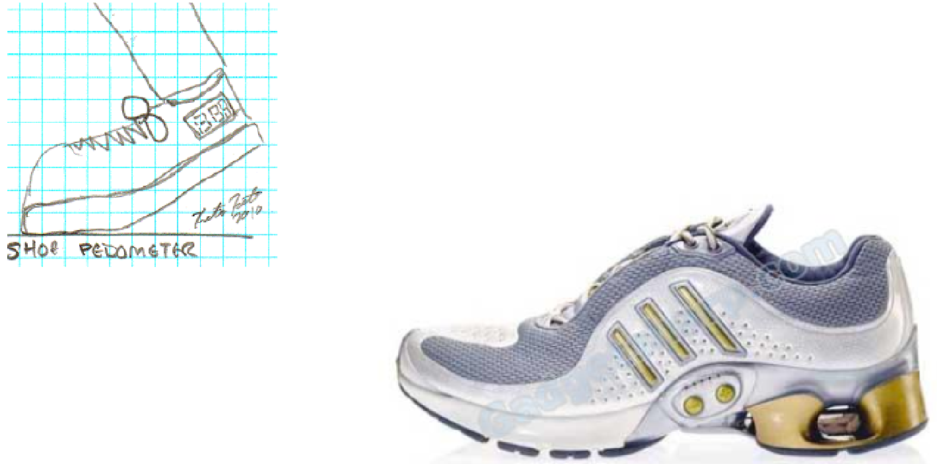
Shoe pedometer

Slide 35
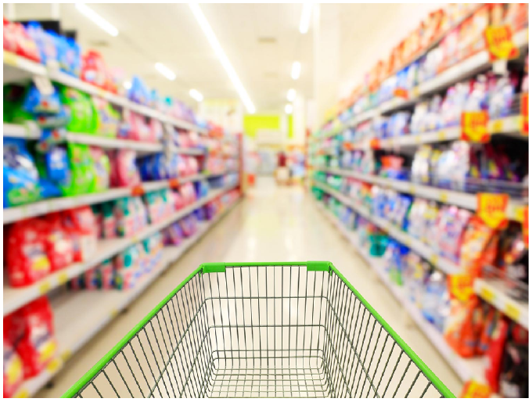
In shops

Slide 36
IoT characteristics
Internet of Things:
Distributed systems
Invisible network
Seamless and efficient utilization
Cheap

Slide 37
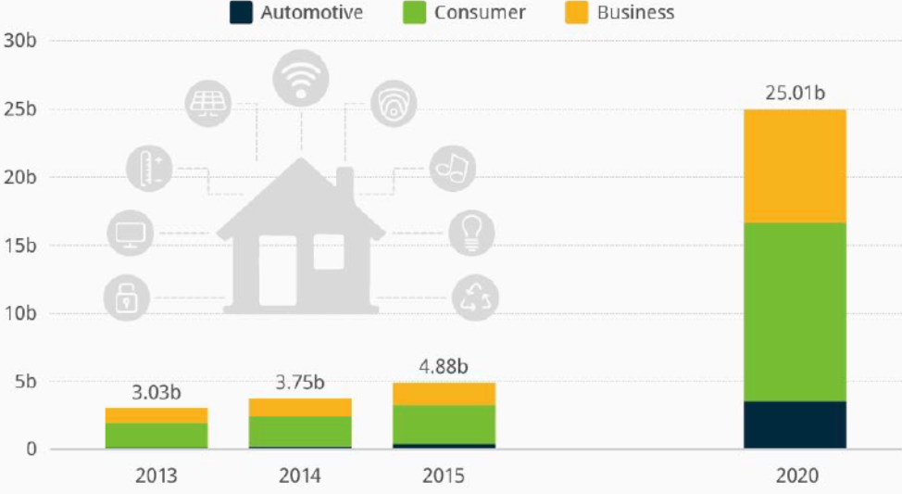
Estimated number (in billion) of smart connected things in use worldwide, by category (Statistica). IoT to hit the mainstream by 2020.

Slide 38
A Thing?
A laptop takes 90% of your attention, a smartphone 40%, "classic" phone 20%, and IoT should take max 0-5% (Intel, 2015)
Calm technology—systems which don’t compete for attention yet are ready to provide utility or useful information when we decide to give them some attention (Mark Weiser).

Slide 39
IoT
There is no standard, proven, manufacturer independent way to implement a complete application for gathering and analysing data from a custom IoT system.

Slide 40
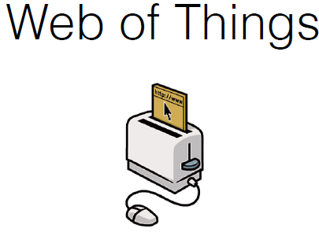
IoT

Slide 41
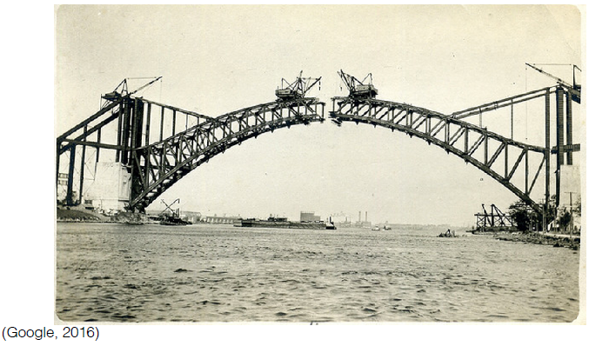
IoT
bridge status monitoring

Slide 42
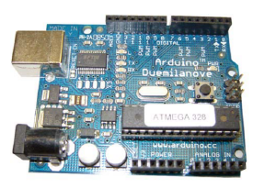
Web of Things
The Internet of Things is the foundation.
Application layer vs network layer.
Standards through HTTP and the web services.
An ecosystem for exposure smart objects / devices.

Slide 43
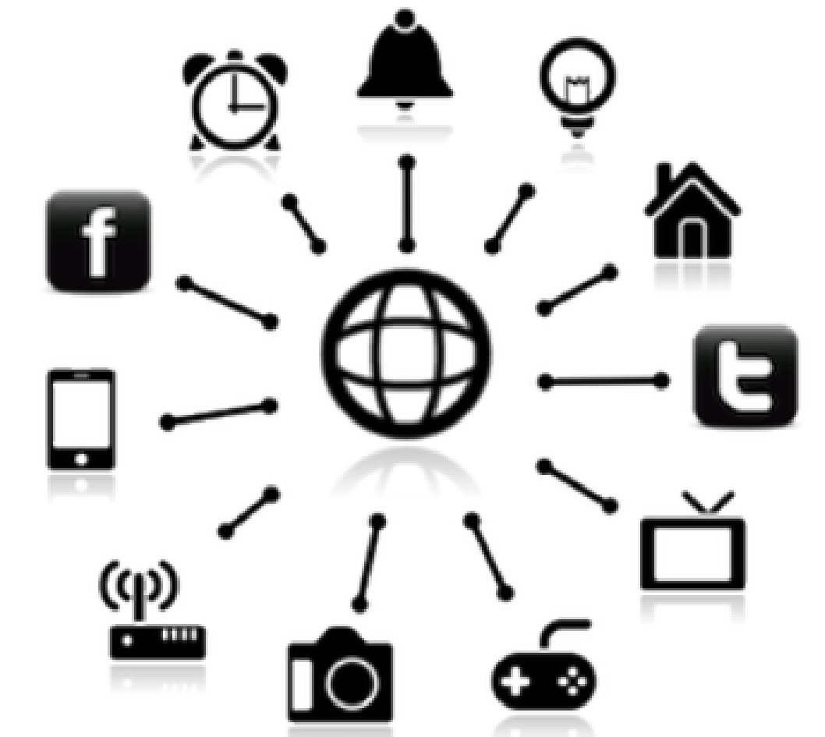
Web of Things
Exposure of real time data
Vertical section cut architecture
- All comm. layers
Integrated part of the web

Slide 44
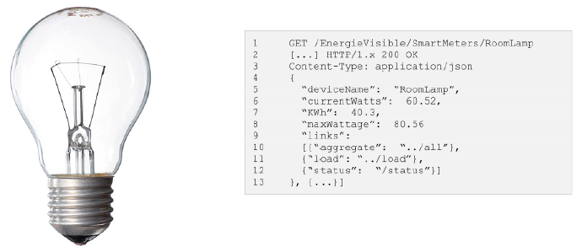
JSON for WoT

Slide 45
Communication
WoT challenges:
Prevalence and adoption
Synchronization of distributed data
Full part of the web

Slide 46
Exercises & next time
Now it's time for exercise!
In this room (A2-12), until 1PM.
Today's exercises:
Tasks for intelligent systems in general.
Tasks to the Internet of Things.
Main topics, next time:
Artificial intelligence: Agents & finite state machines.
IoT: Design principles for connected devices (textbook chapter 2).

